Slide 1




THEMIS ASI 相机各项指标，数据格式，成像后数据处理
报告人：张斐
20201115
Notes:
各位下午好，今天我做的报告的题目是极光弧的纵向传播

Slide 2
CONTENTS
背景
1
2
THEMIS上的相机各项指标
数据格式
3
4
数据处理方法
2

Slide 3
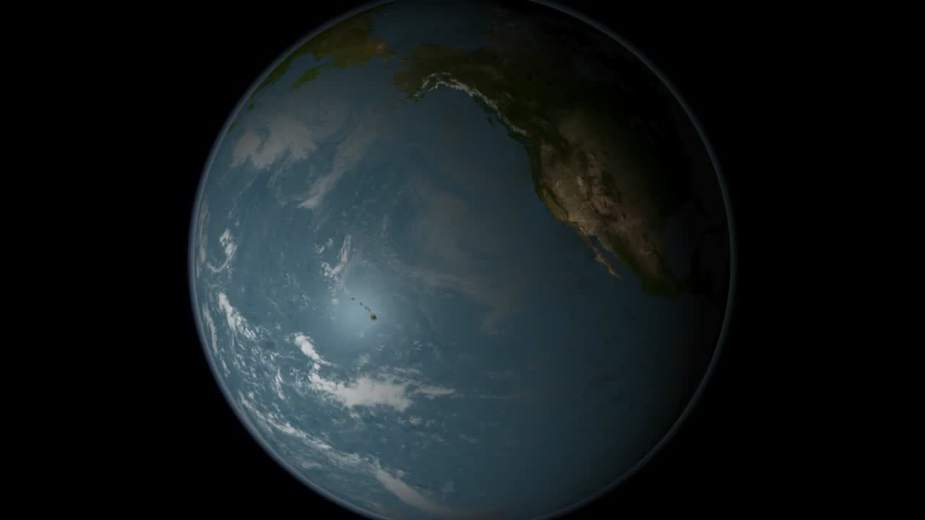
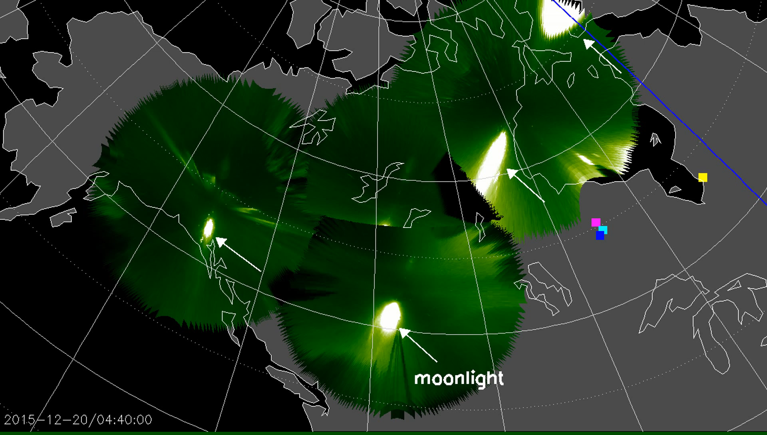
1
背景
THEMIS ALL SKY IMAGER RESULT
3
Notes:
Part1 ,background
As you know, Auroral substorms are often associated with optical ray or bead structures during initial brightening (substorm auroral onset waves).
Nearly Weak
扩张阶段（第一阶段）：T = 0-5获胜。 第一个迹象是大约几千公里长的静弧在大约午夜子午线的中心突然变亮（几分钟内）。 其他弧可能一直保持模糊和扩散状态，直到变亮的弧开始向极点移动为止：在某些情况下，几乎看不见的弧可能会突然变亮，好像在午夜的天空中突然形成了一个新弧。 增亮通常伴随着独特的射线结构的发展。 这种射线结构也称为珠子，可以表征为沿初始增亮弧的光波状结构[Donovan et al。，2006; 亨德森（Henderson），2009年； Rae et al。，2010]（以下简称为亚风暴极光起伏波或为方便起见起伏波）

Slide 4
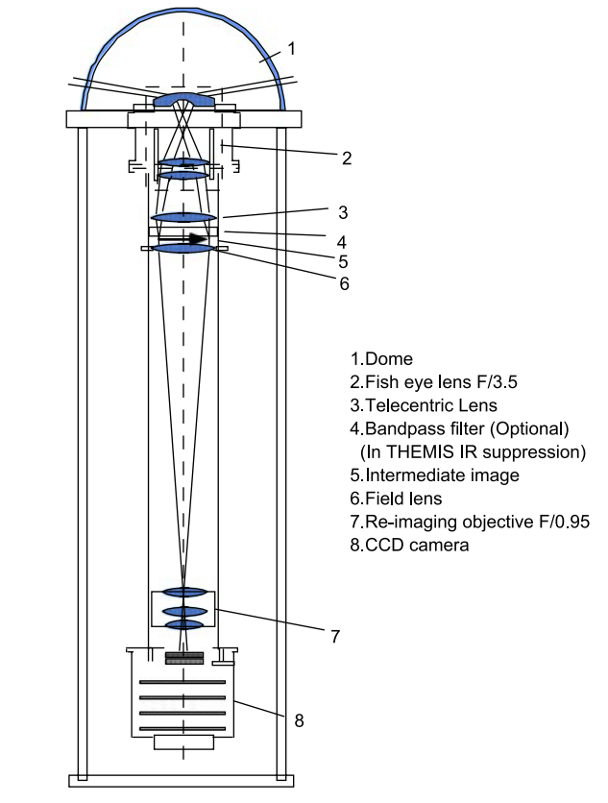
2
THEMIS上的相机各项指标
结构图
The camera is under the dome (1) in a hermetically sealed aluminum chamber with internal thermal insulation . The Peleng fish eye lens (2) is followed by a simple condenser lens, which also serves as a telecentric lens (3) ensuring that the rays coming from the Peleng lens exit pupil are approximately parallel with the optic axis while passing through the filter. This lens moves the apparent center of the Peleng lens exit pupil far away to “infinity,” hence the name “telecentric.” An intermediate image (5) is formed near the filter. Another simple field lens (6) directs all the rays into the entrance pupil of the F/0.95 re-imaging lens (7). There is a 2-dioptercloseup lens (not shown) in front of the re-imaging lens (7) so that the lens operates nearer to infinity conjugate to where its operation was optimized. The CCD camera is a Starlight Express camera containing a Sony black and white CCD, with a USB output connection to the computer.
These lenses were available with moderate speeds (F/3.5) and could be obtained readily. The design permits attachment of such lenses to a wide range of different size CCD cameras with inexpensive coupling op-tics. The Peleng F/3.5 8 mm focal length lens was selected. Its large format image was de-magnified and projected on the CCD by the combination of a close up lens and a Canon F/0.95 25 mm Soligor lens. This arrangement resulted in an all-sky system that uses only inexpensive mass-produced lenses, while having an overall system speed of F/0.95, coupled with excellent resolution. Our estimates show that the camera should produce about 100electrons per pixel per kilo Rayleigh during the selected 1-second exposure.
4
Notes:
Patr2,method event selected
In order to better understand this structure, a certain number of events is necessary, they have formulated two principles for event selection.
1，选择的孤立的亚暴事件，极光和地面磁力计数据在发病前至少30分钟内未显示先前的亚暴活动
2.通过要求极地扩张期间AL或THEMIS AL指数显示出超过100 nT的减少量（与Tanskanen [2009]使用的峰值阈值相同），消除了假破裂事件。

Slide 5
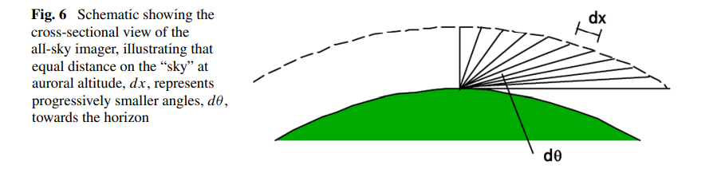
2
THEMIS上的相机各项指标
鱼眼相机的特点
The technique for observing the global aurora from an array of stations is limited by the inherent distortion of the observing geometry, as illustrated in Fig.6. For equal areas on the “sky” at auroral altitudes (∼110 km) represented by dx, the corresponding angular distance dθ for a ground observer is compressed near the horizons, with increasing distance from the station. Conversely, outer pixels in the circular image represent larger regions of auroral precipitation than pixels near the middle.
5
Notes:
Patr2,method event selected
In order to better understand this structure, a certain number of events is necessary, they have formulated two principles for event selection.
1，选择的孤立的亚暴事件，极光和地面磁力计数据在发病前至少30分钟内未显示先前的亚暴活动
2.通过要求极地扩张期间AL或THEMIS AL指数显示出超过100 nT的减少量（与Tanskanen [2009]使用的峰值阈值相同），消除了假破裂事件。

Slide 6
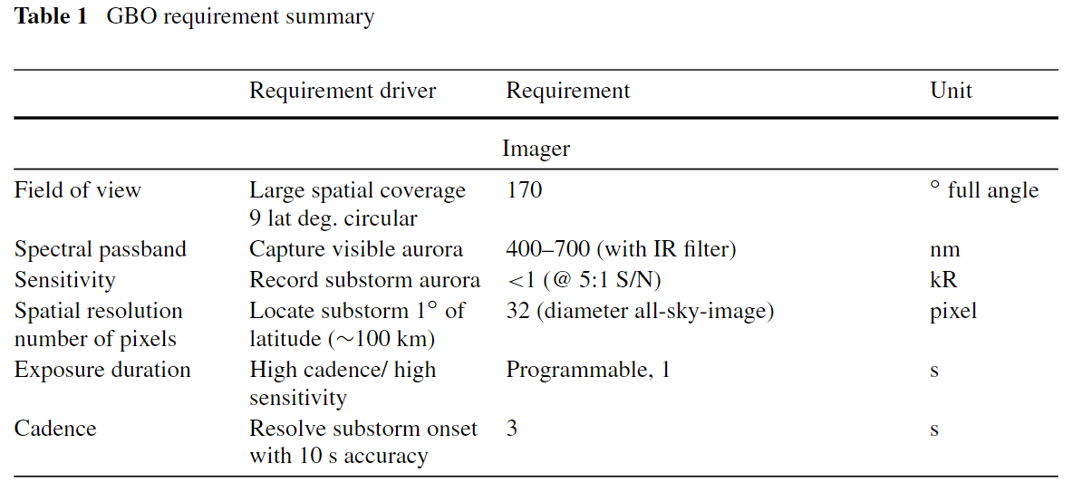
2
THEMIS上的相机各项指标
总体指标
6
Notes:
Patr2,method event selected
In order to better understand this structure, a certain number of events is necessary, they have formulated two principles for event selection.
1，选择的孤立的亚暴事件，极光和地面磁力计数据在发病前至少30分钟内未显示先前的亚暴活动
2.通过要求极地扩张期间AL或THEMIS AL指数显示出超过100 nT的减少量（与Tanskanen [2009]使用的峰值阈值相同），消除了假破裂事件。

Slide 7
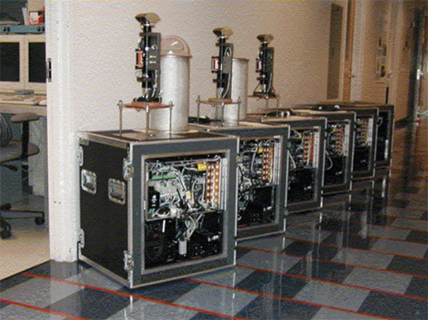
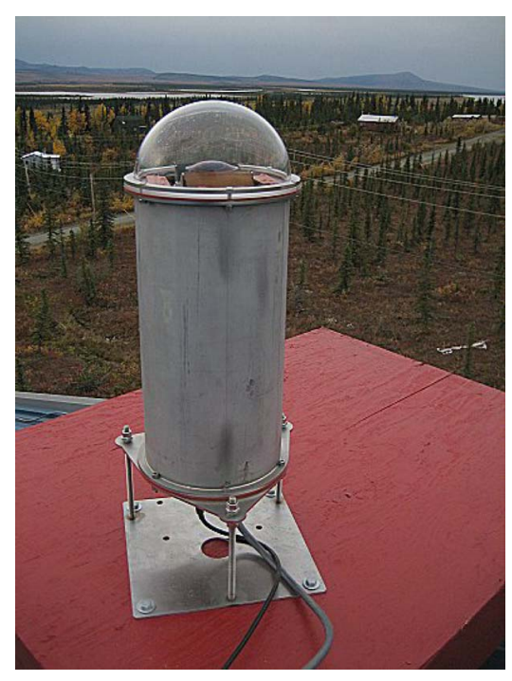
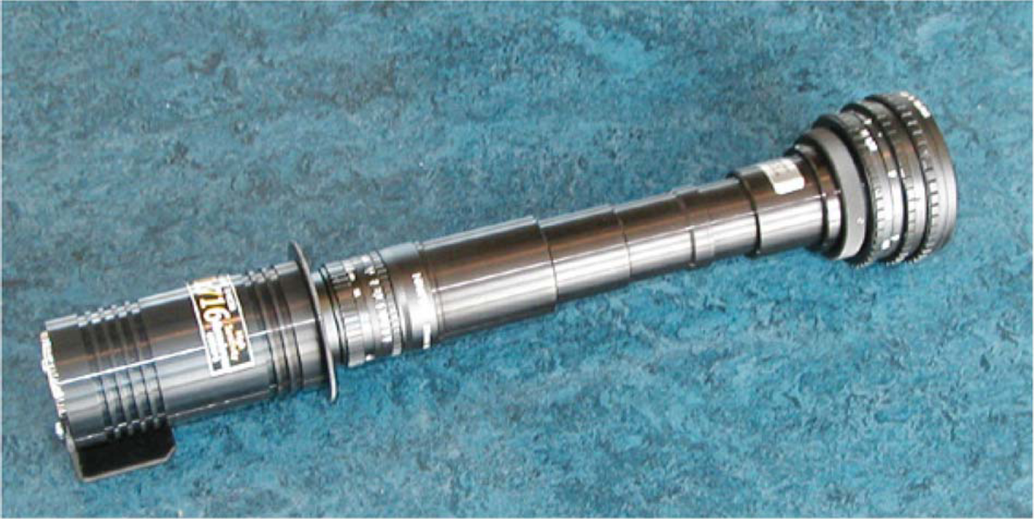
2
THEMIS上的相机各项指标
实物图
Photograph of the actual camera unit assembled
7
Notes:
Patr2,method event selected
In order to better understand this structure, a certain number of events is necessary, they have formulated two principles for event selection.
1，选择的孤立的亚暴事件，极光和地面磁力计数据在发病前至少30分钟内未显示先前的亚暴活动
2.通过要求极地扩张期间AL或THEMIS AL指数显示出超过100 nT的减少量（与Tanskanen [2009]使用的峰值阈值相同），消除了假破裂事件。

Slide 8
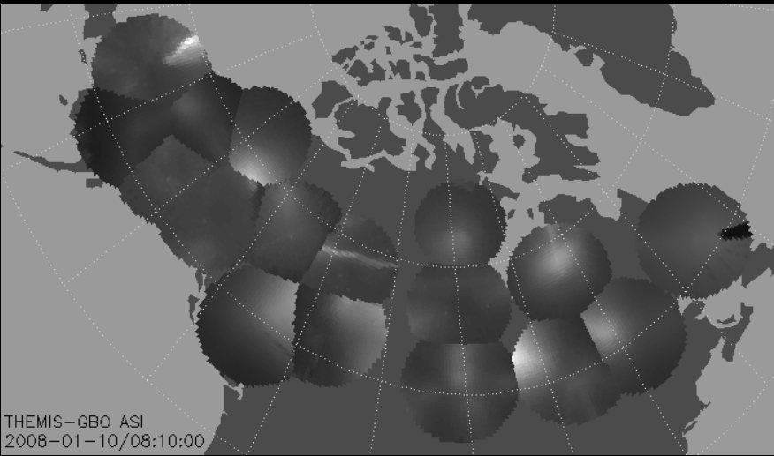
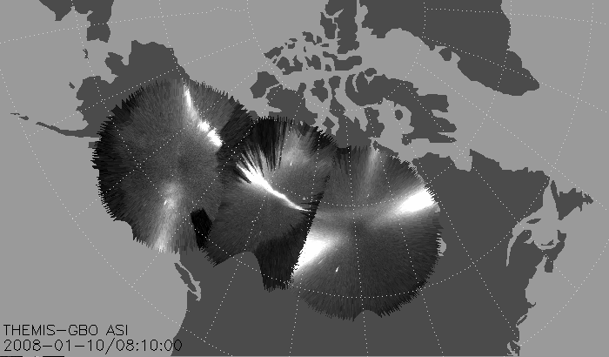
3
数据格式
1
数据文件的区别
Two types of data:
(1) the near real time thumbnail image data, real time keograms produced at the sites and hourly images and magnetometer data to be retrieved electronically via internet on a daily basis
(2) full resolution image data that will be copied from hot swap hard drives mailed back from the sites.
The daily and hourly keograms (32 or 256 pixel vertical scans at 1-min or 6-s cadence) and the thumbnails (at 3-s or 6-s cadence) are the highest temporal resolution data possible given the available bandwidth used in the retrieval.
The ASI hard drive data consist of high spatial resolution 256×256 pixels images at the highest time resolution (3 s).
Both data types are processed to serve as THEMIS GBO data products accessible on the web.
2
8
Notes:
Part3 is case study
These are three typical cases, From left to right, it is propagate westward, both sides, eastward, The red lines trace the initial brightening arcs and then shifted slightly equatorward for not hiding the arcs
(W e)
向西传播波事件中的起始波发生在最小纬度点以西。 双向事件中的波也向西发生，但起始弧的倾斜较小。 相反，向东传播的波浪事件发生在最小纬度点以东。
我们注意到的另一个区别是起纬度。 向西和双向波事件的发生发生在典型的亚暴起伏纬度（〜67°磁纬度[MLAT] [Liou等，2001； Frey等，2004]），而向东传播的波事件发生。 发生在低纬度（63°–64°MLAT）。

Slide 9
3
数据格式
数据文件的类别
Data Product 1
Hourly full average and jpeg compressed 1-minute images. Once an hour , a full jpeg image is transmitted from each GBO site. This format is intended for data quality evaluation, including assessment of the sky clarity over the station. Once a minute, a jpeg compressed full image is also retrieved.
Data Product 4
Magnetometer data. Individual magnetometer station data X , Y , and Z components are presented as a function of time.
Data Product 5
Mosaic. Full mosaics are produced for the entire array from the thumbnail images or, when available, from full images. These data products are available about 2–4days after data collection.
Data Product 2
Clickable KEOGRAMS. A set of Keograms are produced at each GBO station from the full resolution images. These are transmitted as separate files. An example of the available Keograms from all stations is shown in Fig.17in collage form. On the THEMIS science operation center (SOC) web display, these Keograms are accessible directly. Clicking at any UT time, displayed as the horizontal axis on the Keogram, will open one of the GBO summary images (Data Product 3) for the appropriate time and station from the THEMIS gifs produced from the images.
Data Product 3
GBO summary images. This is a set of gif images produced first from the thumbnails that contain 1024 pixel vectors. As the full data sets become available from the mailed hard drives, the thumbnail gif images are replaced with gifs produced from the full fidelity images. On the Keogram in Data Product 2, in the very rightmost column, the presence of the “T” indicates that the gif images still represent the thumbnail data. A click on the Keogram will reveal the appropriate hour data as a collage of gif images taken on the even minute. Clicking on any one image will expand it to the full time resolution (3-scadence) or 20 gif images per minute.
9
Notes:
Part3 is case study
These are three typical cases, From left to right, it is propagate westward, both sides, eastward, The red lines trace the initial brightening arcs and then shifted slightly equatorward for not hiding the arcs
(W e)
向西传播波事件中的起始波发生在最小纬度点以西。 双向事件中的波也向西发生，但起始弧的倾斜较小。 相反，向东传播的波浪事件发生在最小纬度点以东。
我们注意到的另一个区别是起纬度。 向西和双向波事件的发生发生在典型的亚暴起伏纬度（〜67°磁纬度[MLAT] [Liou等，2001； Frey等，2004]），而向东传播的波事件发生。 发生在低纬度（63°–64°MLAT）。

Slide 10
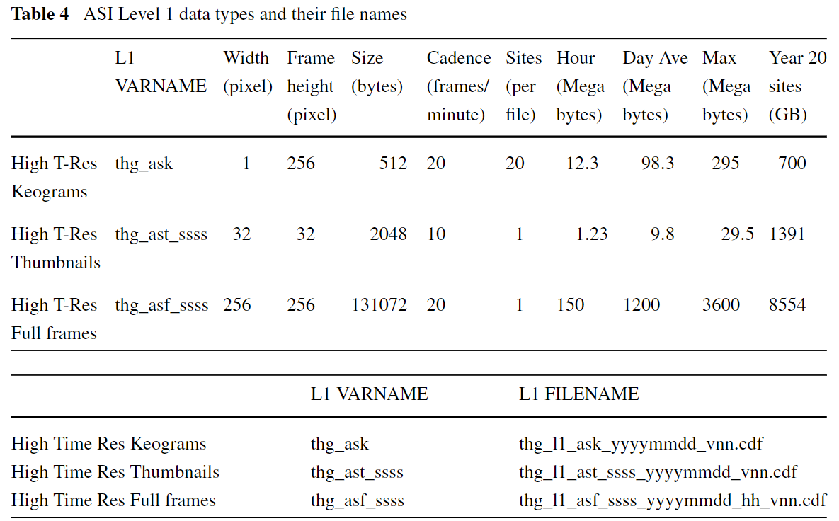
3
数据格式
数据文件的具体格式
The first L1 data product is the high time resolution Keogram produced from the 3-scadence full spatial resolution data.
The second data product is comprised of the thumbnail images at full time resolution. Some of the stations have reduced transmission band width and the near real time data will only support 6-second cadence or 10 exposures per minute . When the full resolution data are retrieved via the mailed hard drives, then the missing alternate frames can be filled in and full time resolution can be restored with 20 frames per minute.
The last L1 CDF set is the full images after they have been copied off the returned hard drives.
10
Notes:
Part3 is case study
These are three typical cases, From left to right, it is propagate westward, both sides, eastward, The red lines trace the initial brightening arcs and then shifted slightly equatorward for not hiding the arcs
(W e)
向西传播波事件中的起始波发生在最小纬度点以西。 双向事件中的波也向西发生，但起始弧的倾斜较小。 相反，向东传播的波浪事件发生在最小纬度点以东。
我们注意到的另一个区别是起纬度。 向西和双向波事件的发生发生在典型的亚暴起伏纬度（〜67°磁纬度[MLAT] [Liou等，2001； Frey等，2004]），而向东传播的波事件发生。 发生在低纬度（63°–64°MLAT）。

Slide 11
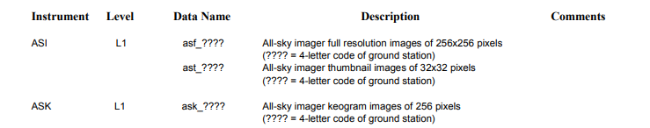
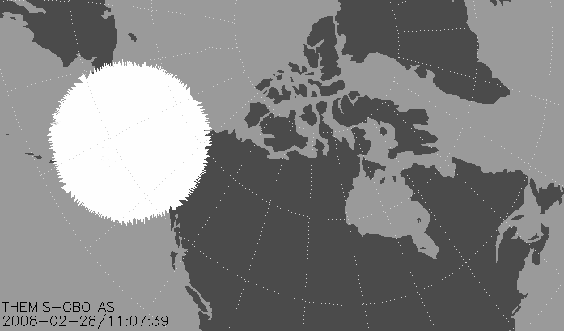
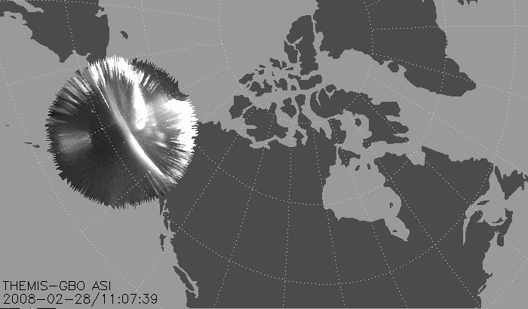
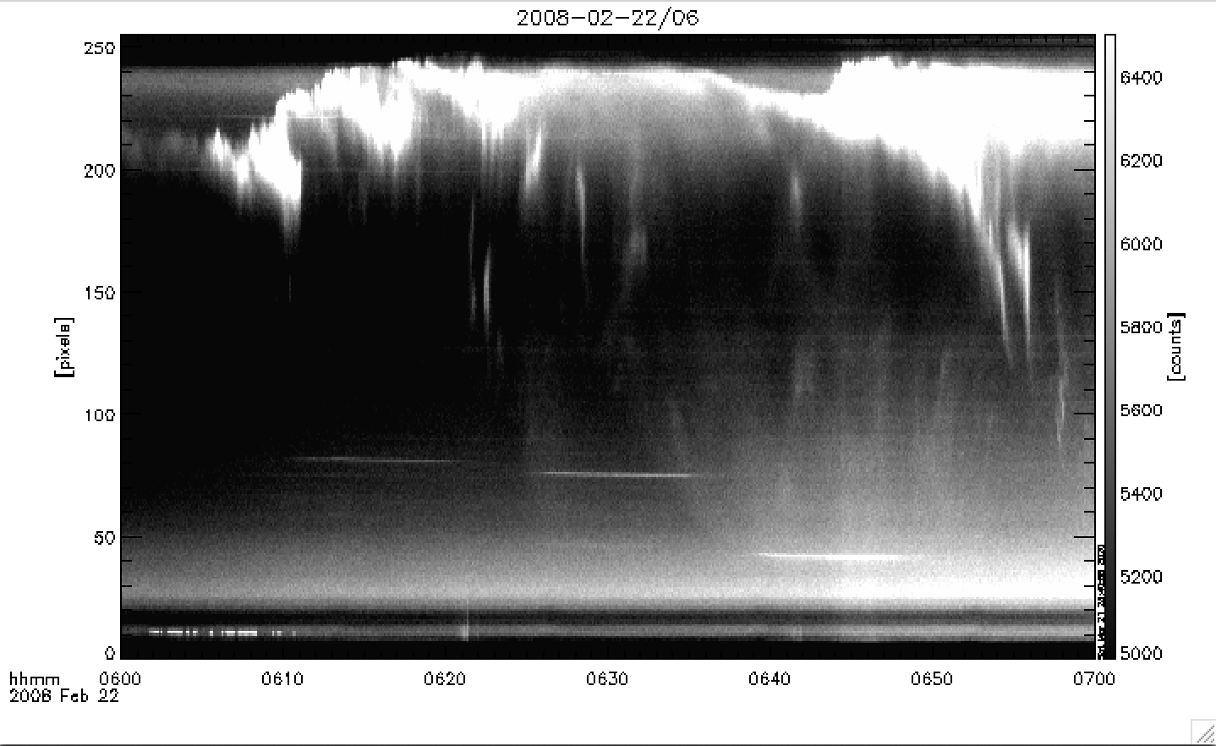
4
数据处理方法
数据文件的选择
ASI and ASK save the raw brightness values of all sky imager captured by the camera,
When we will use thm_asi_create_mosaic.pro create mosaic with THEMIS ASI,
this program will normalize the raw brightness matrix image stored in the asi file,
limiting its range to 0-254, and in the form of 8-bit grayscale show it.
normalization process
asi
asi
ask
Created from raw data
Created by the normalized data
Created from raw data
Brightness range:0-65535
Brightness range:0-254
Brightness range:0-65535
11
Notes:
Part3 is case study
These are three typical cases, From left to right, it is propagate westward, both sides, eastward, The red lines trace the initial brightening arcs and then shifted slightly equatorward for not hiding the arcs
(W e)
向西传播波事件中的起始波发生在最小纬度点以西。 双向事件中的波也向西发生，但起始弧的倾斜较小。 相反，向东传播的波浪事件发生在最小纬度点以东。
我们注意到的另一个区别是起纬度。 向西和双向波事件的发生发生在典型的亚暴起伏纬度（〜67°磁纬度[MLAT] [Liou等，2001； Frey等，2004]），而向东传播的波事件发生。 发生在低纬度（63°–64°MLAT）。

Slide 12
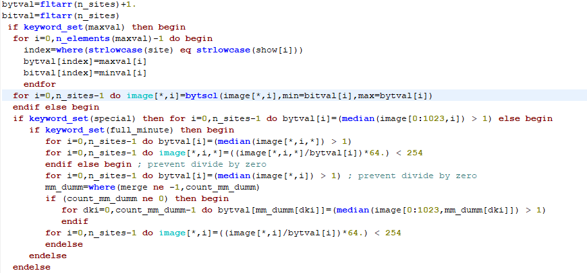
4
数据处理方法
1.The normalization process is to divide the unprocessed image matrix by the median value of the unprocessed image first, Median smoothing replaces each point with the median of the one- or two-dimensional neighborhood of a given width. It is similar to smoothing with a boxcar or average filter but does not blur edges larger than the neighborhood.
数据文件的归一化处理
The code for the normalization process
2.Then the matrix is multiplied by 64, and the value less than 254 is assigned to the new image matrix, completing the unprocessed image matrix to the value limit of 0-254 The normalization process of the image matrix in the range
12
Notes:
Part3 is case study
These are three typical cases, From left to right, it is propagate westward, both sides, eastward, The red lines trace the initial brightening arcs and then shifted slightly equatorward for not hiding the arcs
(W e)
向西传播波事件中的起始波发生在最小纬度点以西。 双向事件中的波也向西发生，但起始弧的倾斜较小。 相反，向东传播的波浪事件发生在最小纬度点以东。
我们注意到的另一个区别是起纬度。 向西和双向波事件的发生发生在典型的亚暴起伏纬度（〜67°磁纬度[MLAT] [Liou等，2001； Frey等，2004]），而向东传播的波事件发生。 发生在低纬度（63°–64°MLAT）。

Slide 13
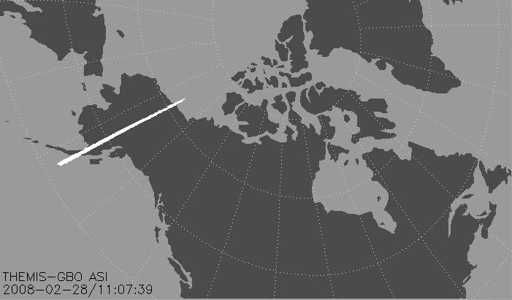
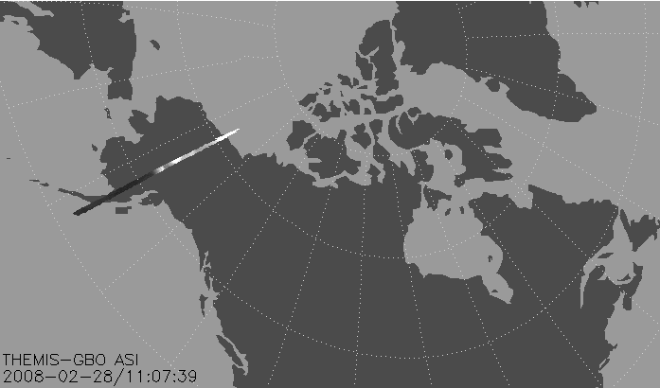
Example
Compare raw data and normalized data
2008-02-28/11:07:39 Station : MCGR
Created from raw data
Created by the normalized data
Brightness: MAX:63099.5
MIN:0
Brightness: MAX:254
MIN:0
13

Slide 14

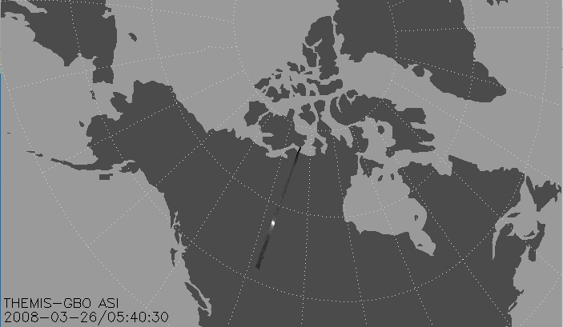
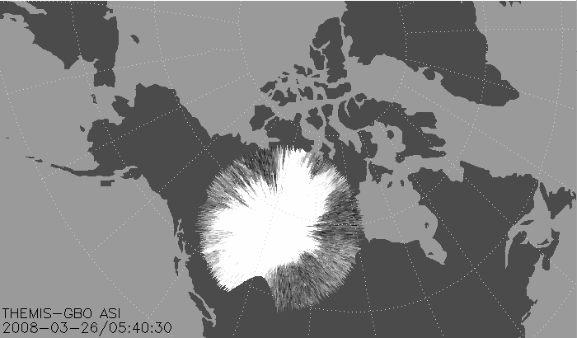
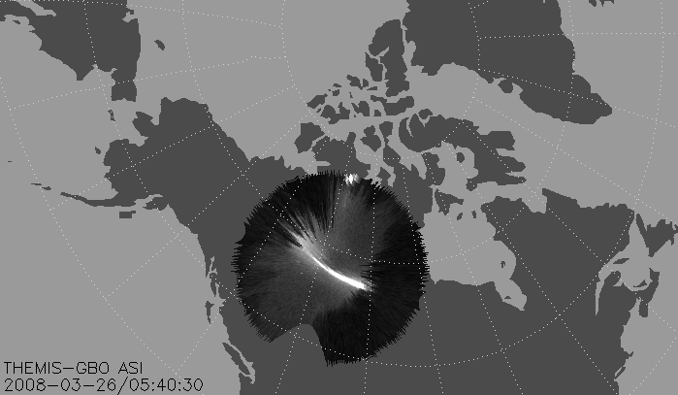
Example
Compare raw data and normalized data
2008-03-26/05:40:30 Station : FSMI
Created from raw data
Created by the normalized data
Brightness: MAX:8583.98
MIN:0
Brightness: MAX:254
MIN:0
14

Slide 15
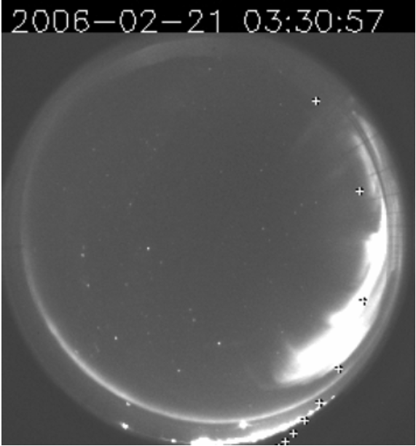
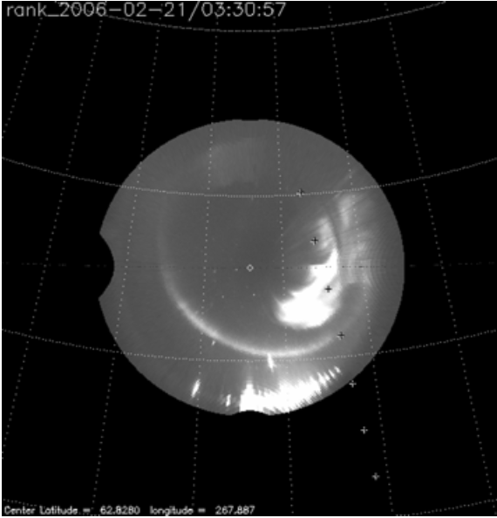
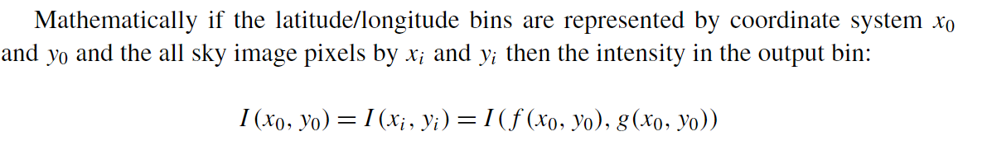
4
数据处理方法
ALL SKY IMAGER的投影
Figures(a) and (b) illustrates an image from Rankin Inlet. Figure(a)represents the original image as it is read out and digitized from the CCD. A rayed arc is seen on the right half of the image and a thin, long east-west extended arc is seen near the bottom, in the vicinity of the horizon. Lights from a nearby settlement can be seen at the very bottom right of the image. The crosses represent the magnetically projected track of the NASA FAST auroral satellite that was passing through the field of view. Figure(b) is a representation of the same all-sky image projected on an imaginary layer at 110 km altitude. The distortions produced by this treatment are quite evident—the regions near the horizons are greatly extended . The method to create this image is called “backward projection” because this picture was produced by starting from the final latitude/longitude pixel matrix. This matrix represents the “bins” on the sky at an assumed 110 km altitude. These bins on the final image matrix are mapped to the appropriate pixels in the all-sky camera image. The pixel intensity in the all sky image pixel is simply copied as the output intensity in the latitude/longitude bin . This method is very simple and it overcomes the complexities of the mismatch in the area between the pixels in the all sky camera image and the corresponding latitude/longitude bins. In cases when the latitude/longitude bins spans multiple pixels in the all-sky camera image, the intensity of only one of the pixels is used. This procedure does not make use of the ultimate SNR obtainable from the co-adding of multiple pixels, however, in general there is no point in enhancing the SNR in small selected region of the image. In cases when several latitude/longitude bins correspond to a single all sky pixel the same intensity is used repeatedly for all the bins.
b
a
The same all-sky image backward-projected and shown on a geographic latitude/longitude grid
where the functions xi=f(x0,y0)and yi=g(x0,y0)define the image pixel coordinates in terms of the corresponding output bin coordinates.
15
Notes:
Part3 is case study
These are three typical cases, From left to right, it is propagate westward, both sides, eastward, The red lines trace the initial brightening arcs and then shifted slightly equatorward for not hiding the arcs
(W e)
向西传播波事件中的起始波发生在最小纬度点以西。 双向事件中的波也向西发生，但起始弧的倾斜较小。 相反，向东传播的波浪事件发生在最小纬度点以东。
我们注意到的另一个区别是起纬度。 向西和双向波事件的发生发生在典型的亚暴起伏纬度（〜67°磁纬度[MLAT] [Liou等，2001； Frey等，2004]），而向东传播的波事件发生。 发生在低纬度（63°–64°MLAT）。

Slide 16
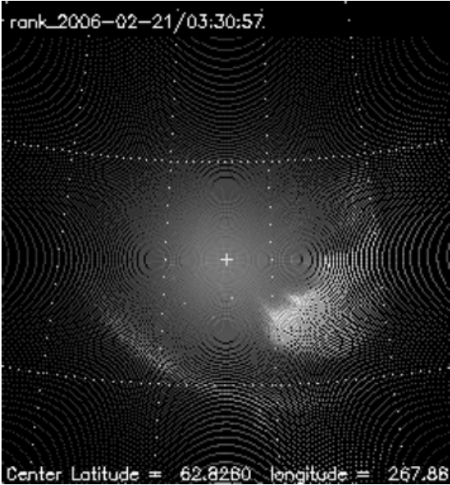

4
数据处理方法
ALL SKY IMAGER的投影
Figure(a)presents the same image in a forward-projected transformation, in which pixels in the original image (see Fig.a) are transformed to the 110 km altitude region and then projected onto a latitude/longitude coordinate system. On a 256×256 output image matrix , not all pixels receive information due to the coarseness of the grid. Upon close inspection , this image is sparsely populated with light, especially near the outer regions.
Figure(b)illustrates how a matrix of similar size bins of approximately 30 km×30 km projected on the sky would translate to various size bins on the original image. Each white point on the image represents the corners of approximately equal area bins at 110 km altitude on the “ sky .” The minimization of the data volume for NRT transmission to the home base was a high priority. We use a data compression scheme that takes advantage of the fact that the all-sky cameras over sample the central region of the image. In this scheme, a 1024-element vector is generated from the all-sky images, where each element represents the intensity of an approximately equal area regions of the aurora. These vectors are transmitted through the internet .
a
b
Upon receiving the data. the 1024-element vectors are converted into reduced resolution thumbnails. These thumbnails satisfy the Level 1 requirements of the THEMIS GBO pro-gram because they retain the spatial and temporal resolution necessary to locate and time the substorm onsets. The thumbnail images permit the construction of quasi global auroral images, so-called mosaics. These mosaics are produced as soon as the NRT data are received through the internet—usually with less than one day delay.
16
Notes:
Part3 is case study
These are three typical cases, From left to right, it is propagate westward, both sides, eastward, The red lines trace the initial brightening arcs and then shifted slightly equatorward for not hiding the arcs
(W e)
向西传播波事件中的起始波发生在最小纬度点以西。 双向事件中的波也向西发生，但起始弧的倾斜较小。 相反，向东传播的波浪事件发生在最小纬度点以东。
我们注意到的另一个区别是起纬度。 向西和双向波事件的发生发生在典型的亚暴起伏纬度（〜67°磁纬度[MLAT] [Liou等，2001； Frey等，2004]），而向东传播的波事件发生。 发生在低纬度（63°–64°MLAT）。

Slide 17
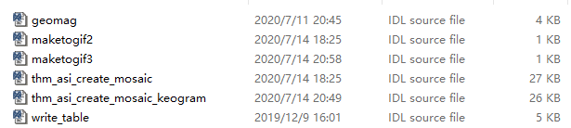
Code introduction
geomag: Convert the matrix holding the geographic coordinate system data into the geomagnetic coordinate system
maketogif2: Used to get ewogram data
maketogif3: Used to get ewogram data
thm_asi_create_mosaic: Set parameters for making mosaic
thm_asi_create_mosaic_keogram: Set parameters for making keogram
Write_table: Write matrix data to txt file
17

Slide 18
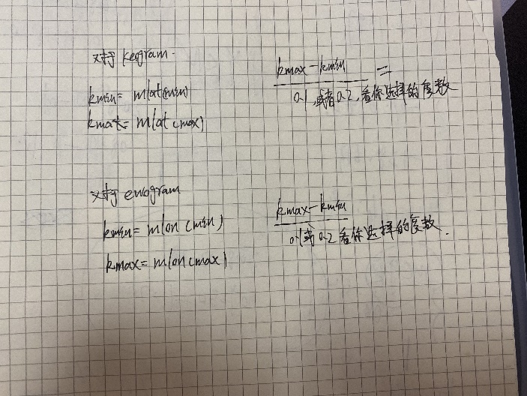
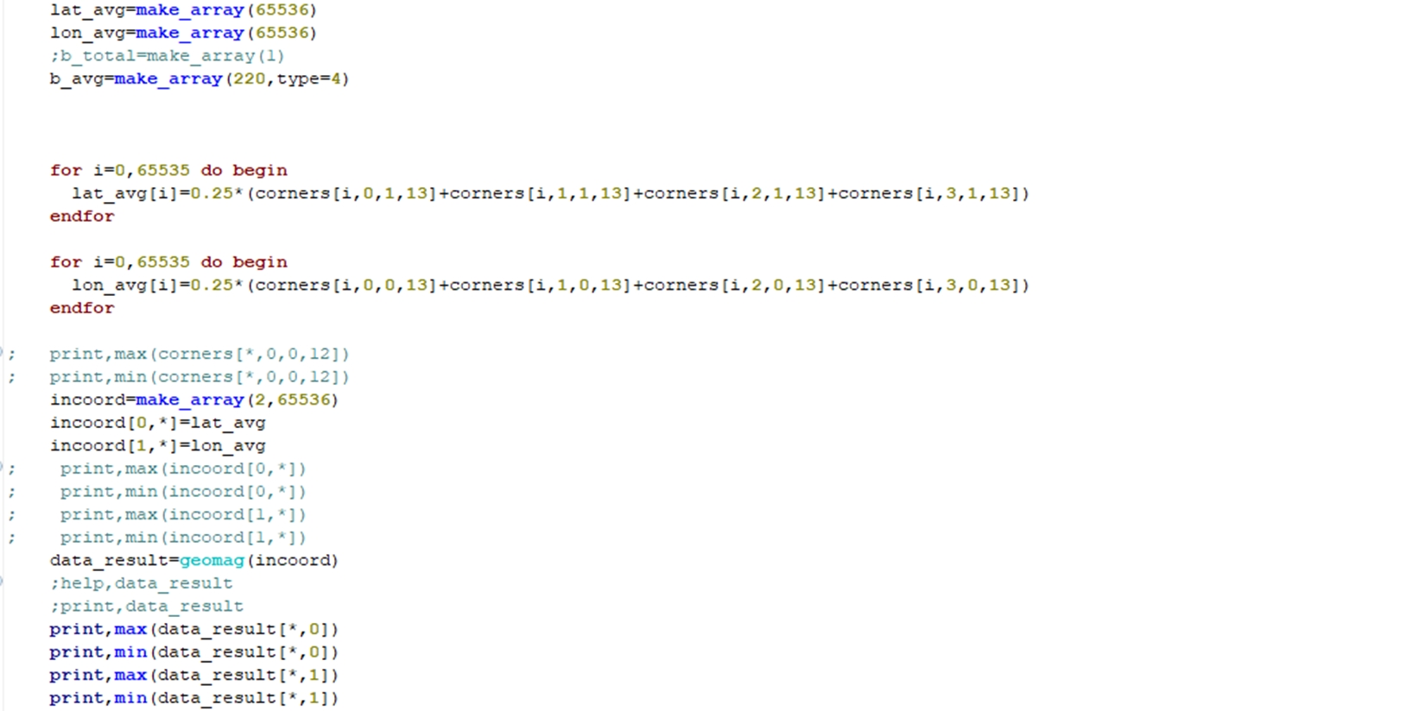
4.2Parameter introduction and modification
Code from thm_asi_create_mosaic.pro and thm_asi_create_mosaic_keogram.pro
corners contains the location information of all sky imager
latitude of four corners of pixel
latitude
Code of station (Need to be modified)
The purpose of this code is to average the latitude and longitude of the four corners of the pixel in the corners matrix into a value instead
longitude
Convert the averaged latitude and longitude into geomagnetic latitude and longitude
18

Slide 19
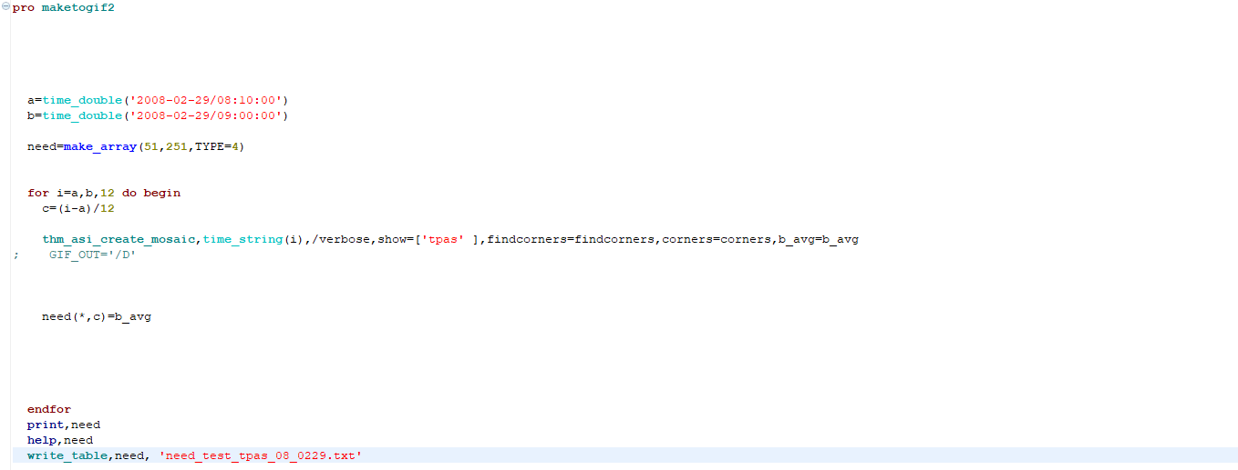
4.2Parameter introduction and modification
Set time scale
19

Slide 20
4.3 Run the program and get the data
make mosaic
Select the station you want and modify the station code in the code
2. Choose the time range and time scale you want
3.run
20

Slide 21
4.3.1 Example of make mosaic
Enter thm_asi_create_mosaic,'2008-02-29/08:23:03',/verbose,show=['tpas']
Wait for the end of the program to get a mosaic
21

